Slide 1
Inclusion Center Redesign
Chandler North, Parisa Mardanlou, Edwin Bey

Slide 2
Introduction
Over the Course of the last three weeks we have gone through many processes to redesign and modernize The Inclusion Center webpage. With a goal to modernize and introduce a better navigation on both Desktop and Mobile. Our redesign process brought out some important changes that need to be made in order to produce a smoother process. Today we are excited to show you what those changes are and why they are for the best for the organizations and its members.

Slide 3

Research Phase: Getting to know the Users
We want to be able to empathize with our users and discover their motivations and thought processes when coming to this site. The key ways we plan on getting a full understanding is through the following tools and methods for our Research Plan:
Reach out to stakeholders
Protopersona
User surveys
User interviews
Affinity Diagram
User insights
Problem Statement

Slide 4
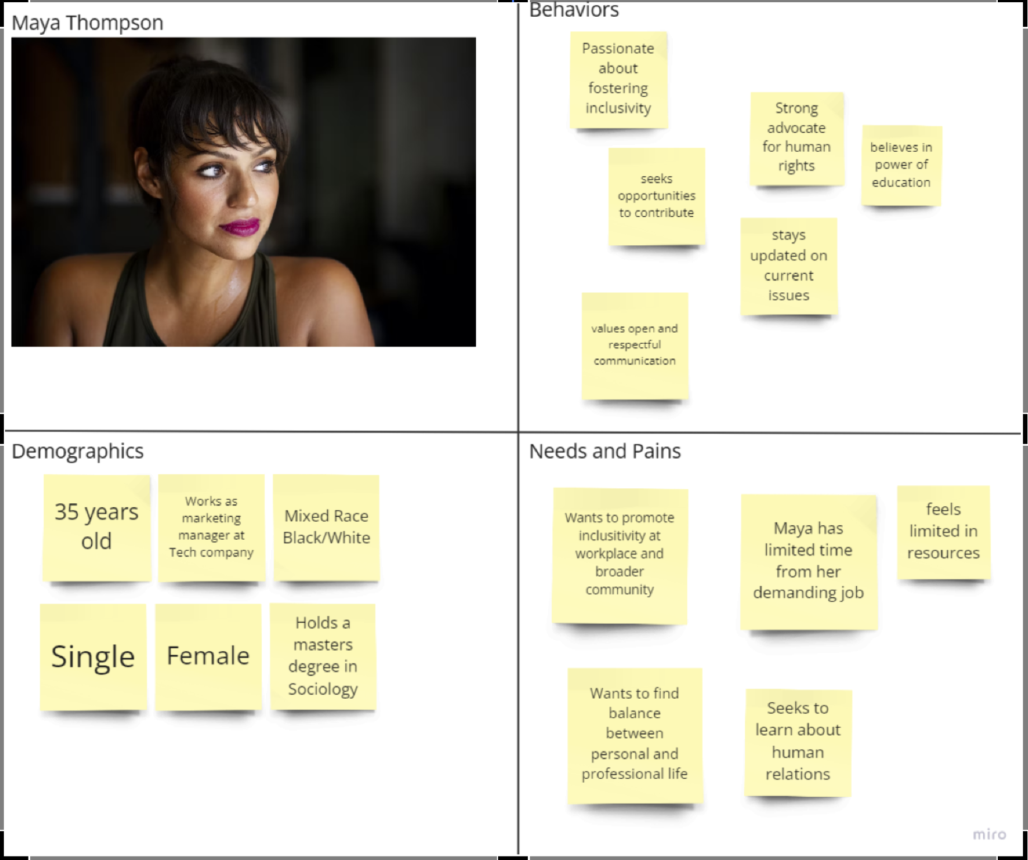
Proto-persona Creation

Slide 5
Developing and Implementing the User Surveys and Interviews
Develop:
Created a 8 questionnaire survey: 5 multiple choice and 3 open ended questions.
Created an interview plan with 8 question involving before and after visiting the organizations page
Implemented:
Survey produced good results with 12 people responding and providing insight and feedback on the website.
Interview provided in person feedback, with some follow up questions we were able to pull information that helped us understand what users are valuing and looking for.

Slide 6
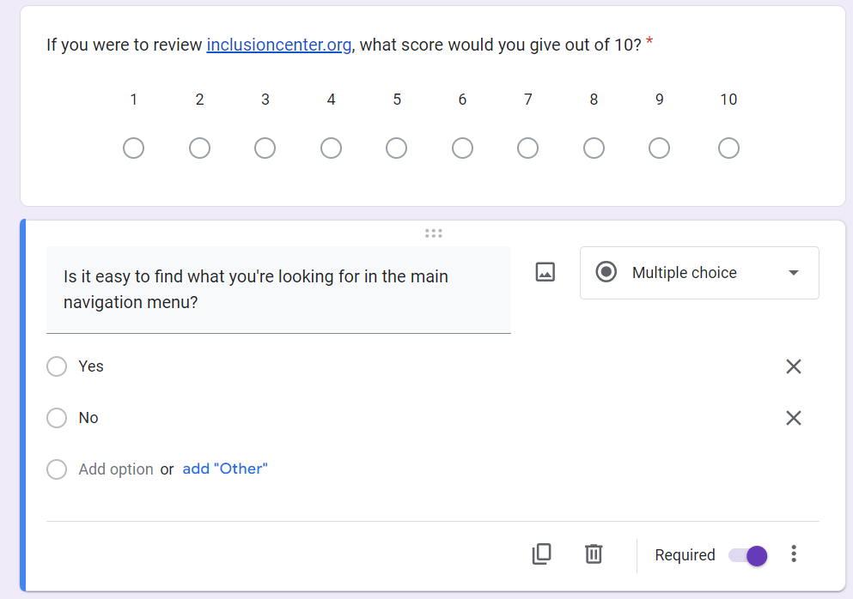
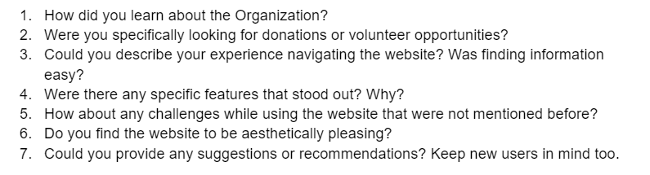

Sample Examples for Survey and Interview
View User Interview
View User Survey

Slide 7
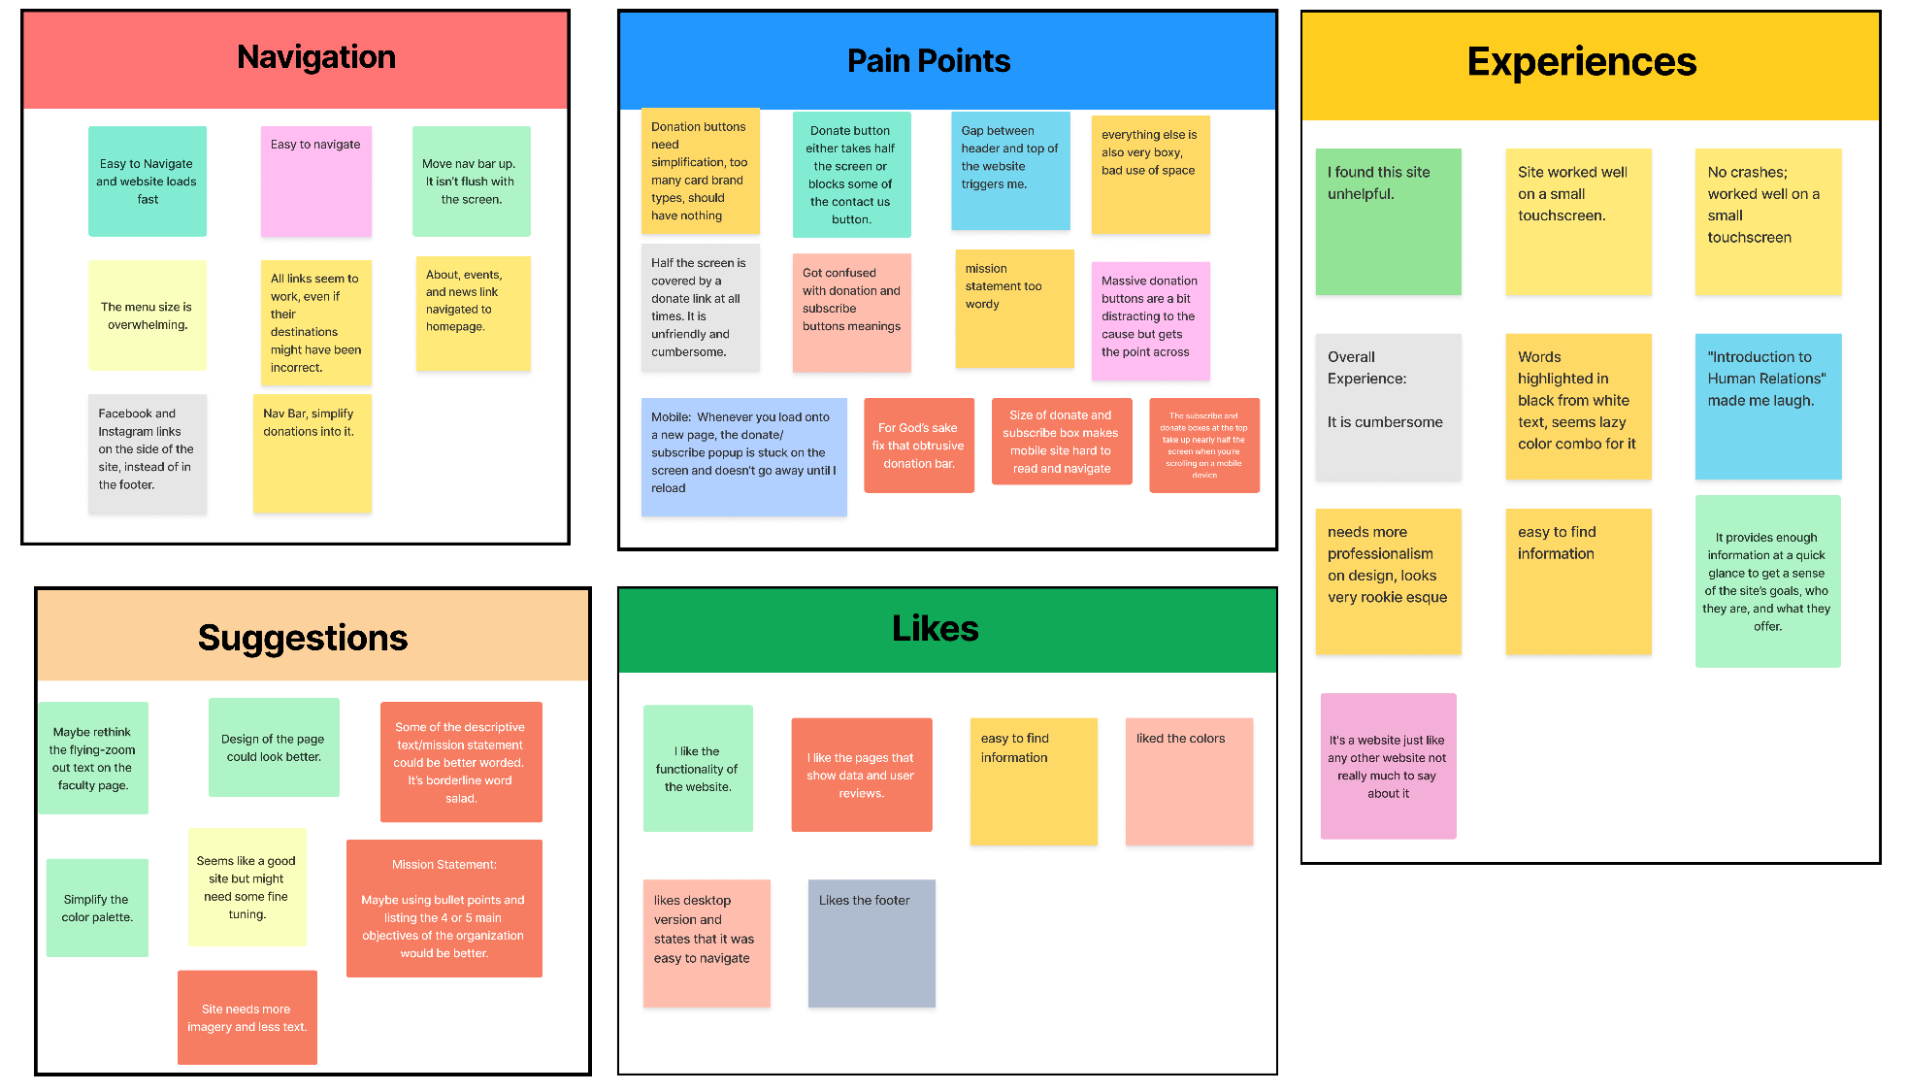
Affinity Diagram

Slide 8
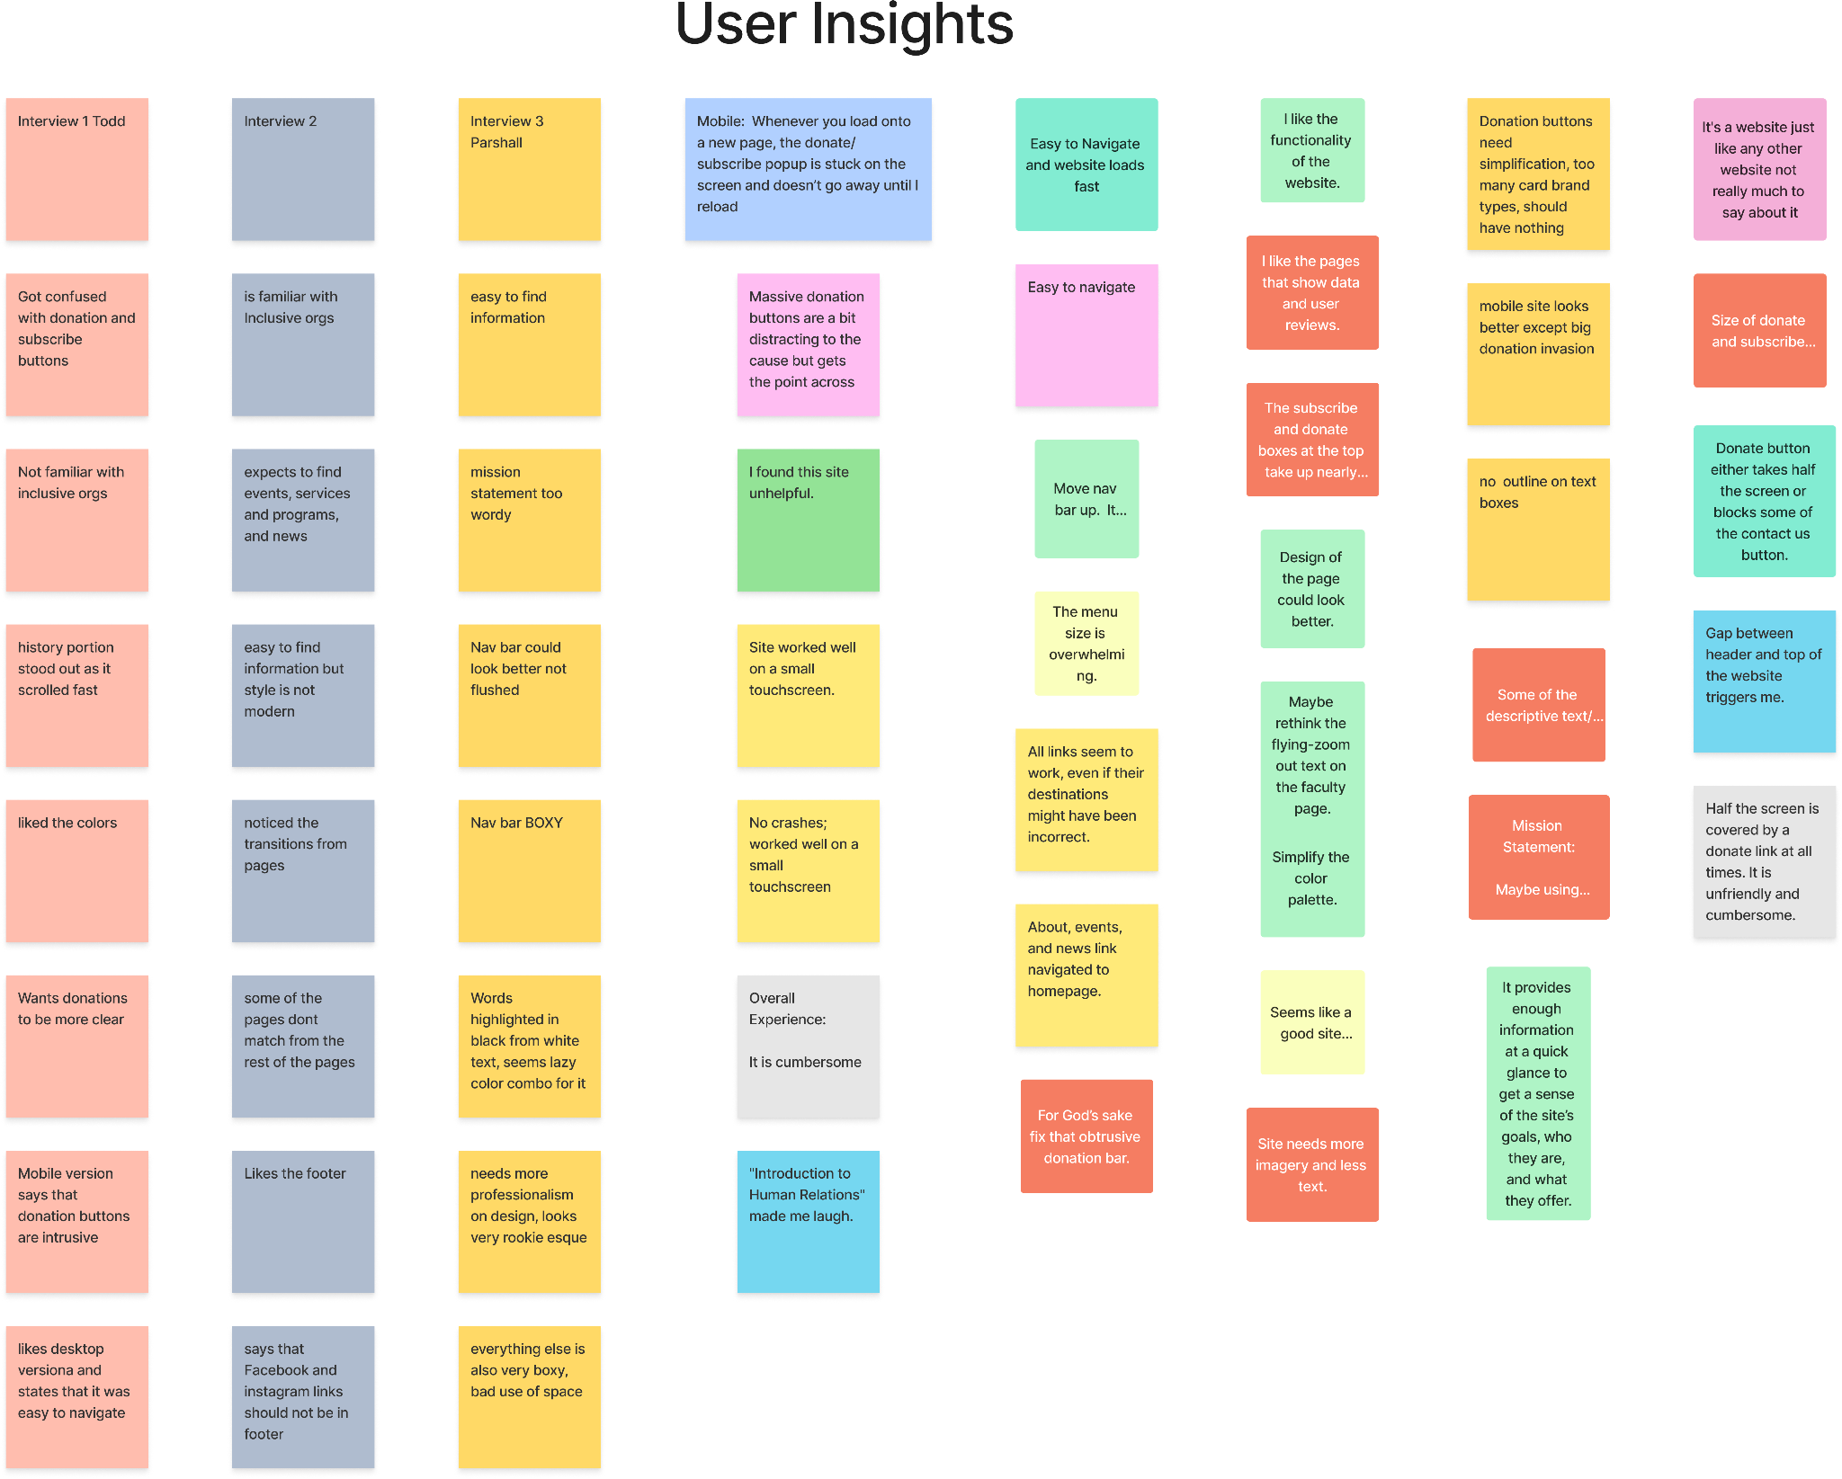
Here we gathered the information from the users we interviewed and surveys. Along with our interview we made them go through the webpage to add and pinpoint issue we may want to be aware of. Here are the results
User Insight in Figma

Slide 9
Problem Statement
Users have provided feedback indicating issues with the mission statement, navigation bar, and donation buttons on the website, which are affecting user experience and usability. The mission statement is word salad and lacks clarity, making it difficult for users to understand the purpose of the organization. The navigation bar is visually unappealing due to spaces in between the search bar, which triggered a negative response to some. Additionally, the navigation buttons do not meet with modern design standards. On the mobile version of the website, the donation buttons take up excessive screen space, causing frustration. These problems negatively affect user experience to a site some believe is good if none of these were prevalent.

Slide 10
Analysis Phase: Understanding Needs
Persona
User Path
Journey map
Heuristics evaluation
Information architecture analysis
Site map

Slide 11
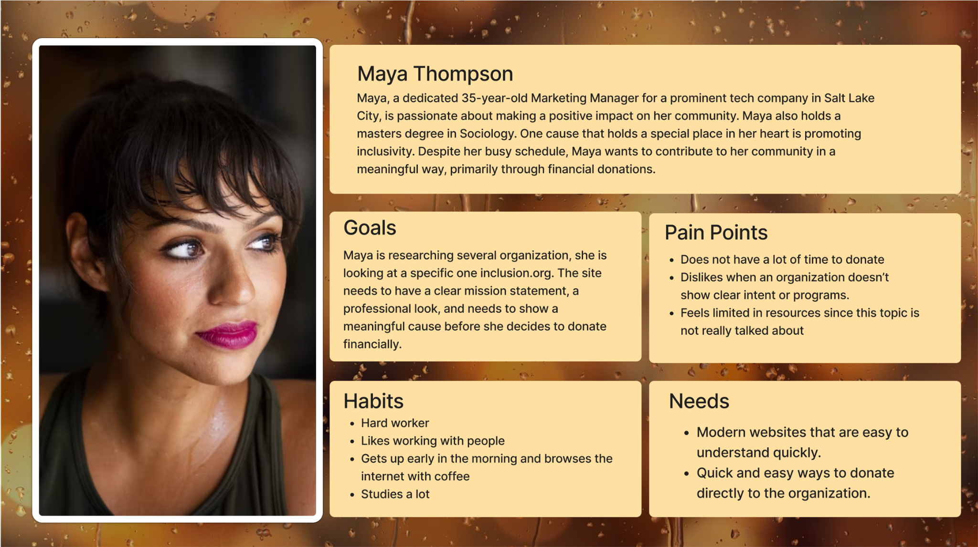

Slide 12
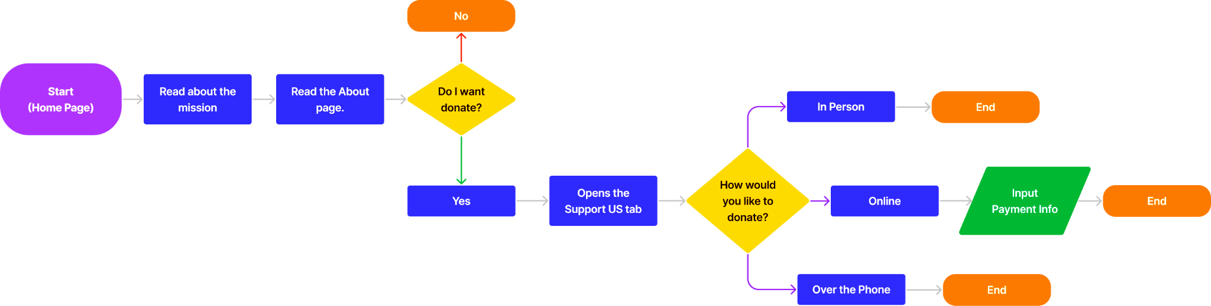
User Path
Here is the User Path Maya Thompson will go through when scrolling to the site.
View User Path

Slide 13
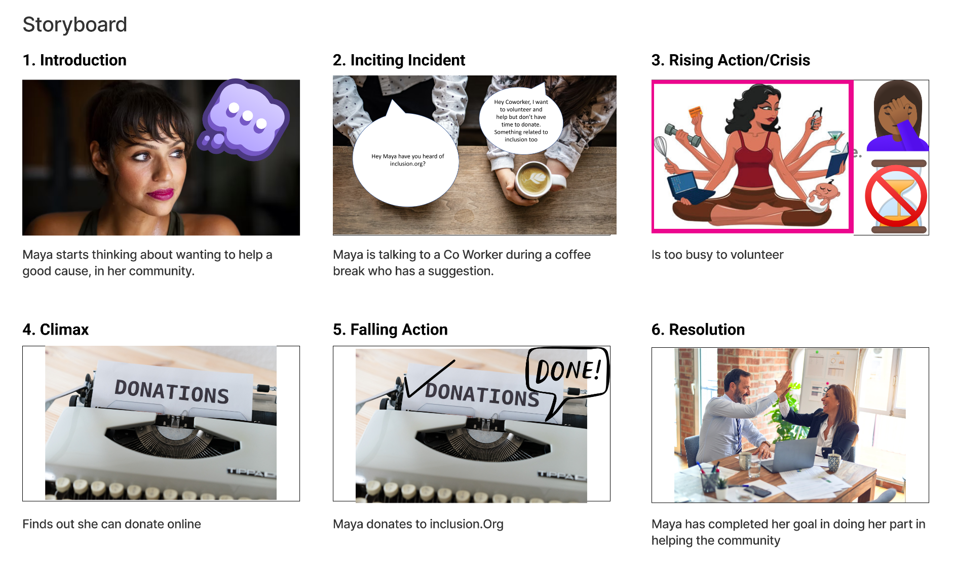

Slide 14
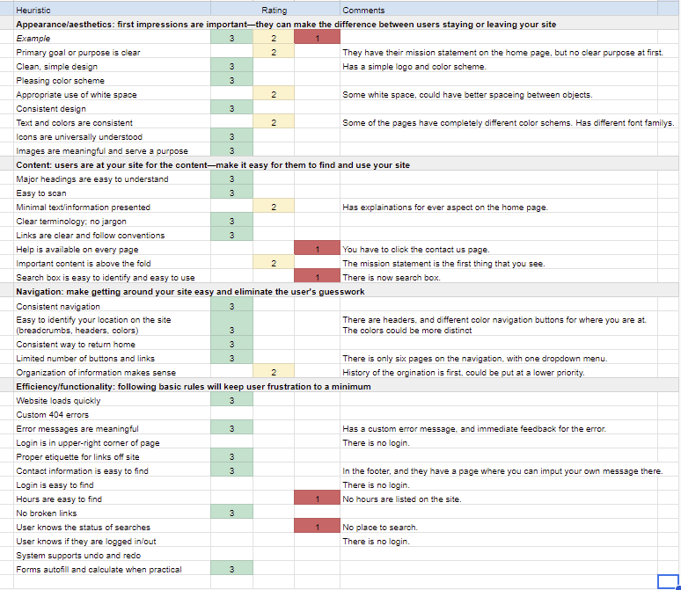
Heuristic Evaluation
In our heuristic evaluation, we came up with the ratings for the website’s different features and content. Main points we found was that navigation wasn’t really a issue.

Slide 15
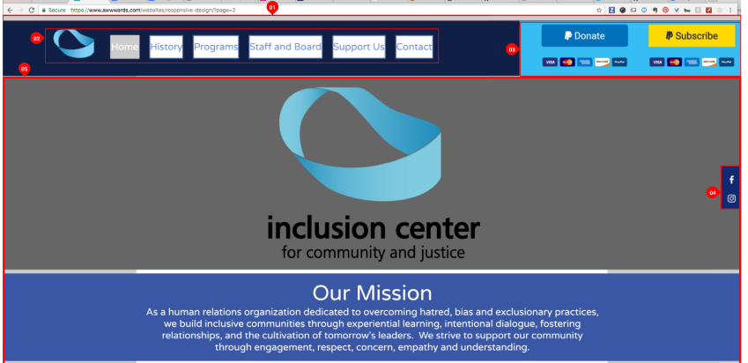
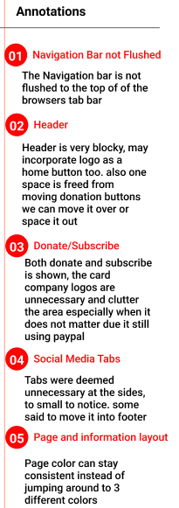
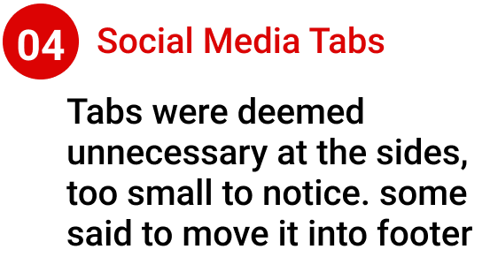
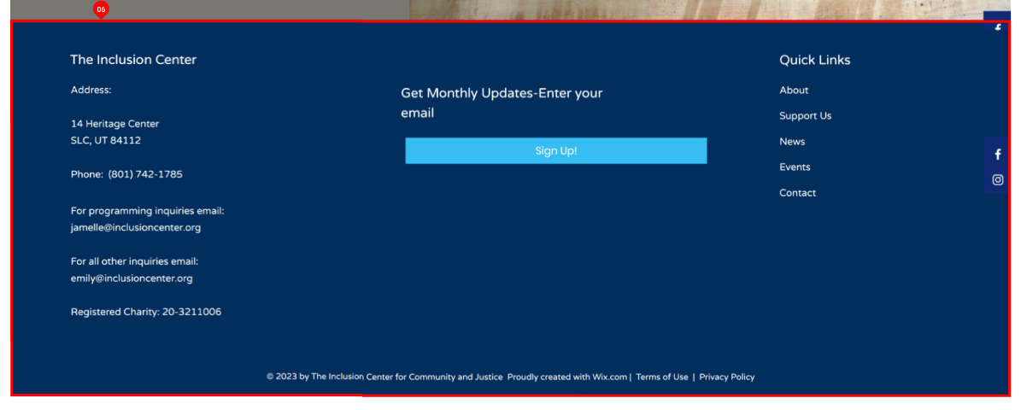
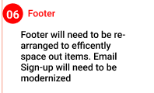
1
2
3
5
4
6
Information Architecture

Slide 16
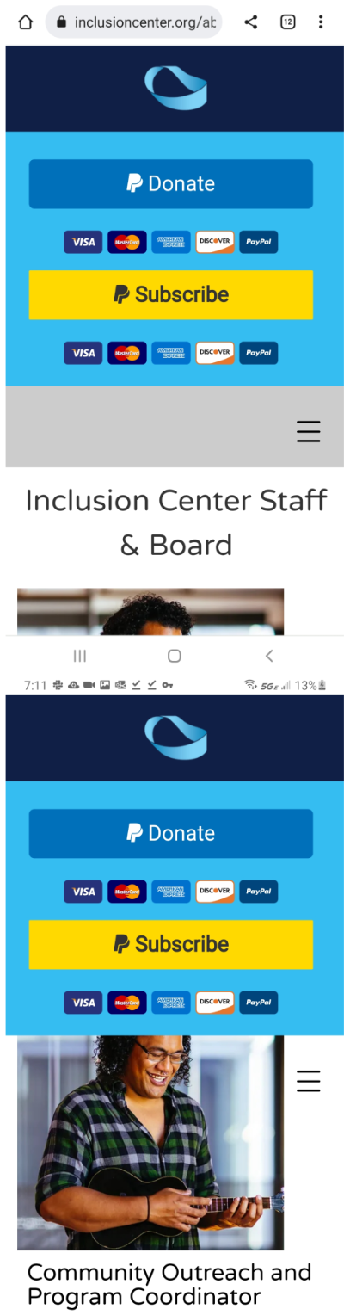
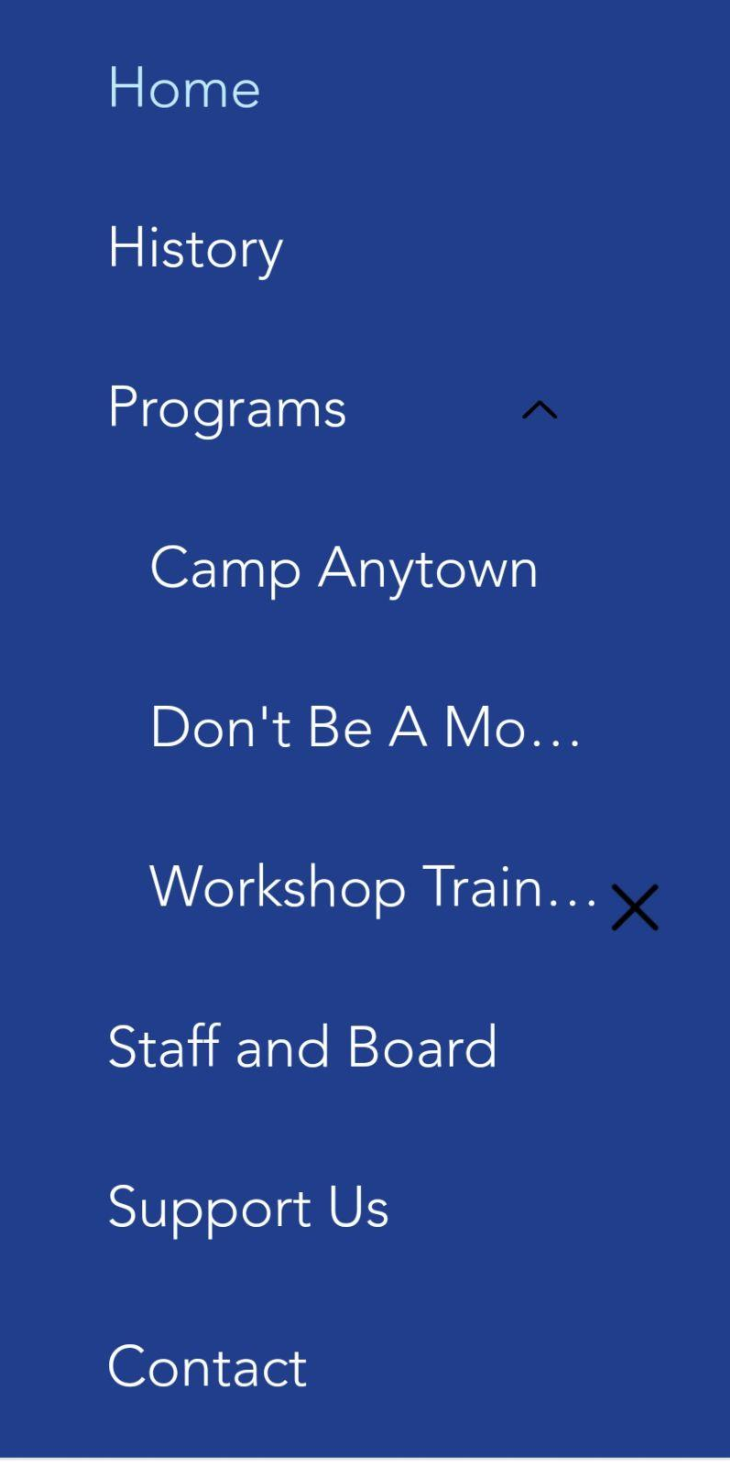
Mobile Specific Issues
On the Mobile App, the user has to scroll through half of the screen to read about any topic or member of the Inclusion Center for Community and Justice
Hamburger Menu is hard to read and see what is selected.

Slide 17
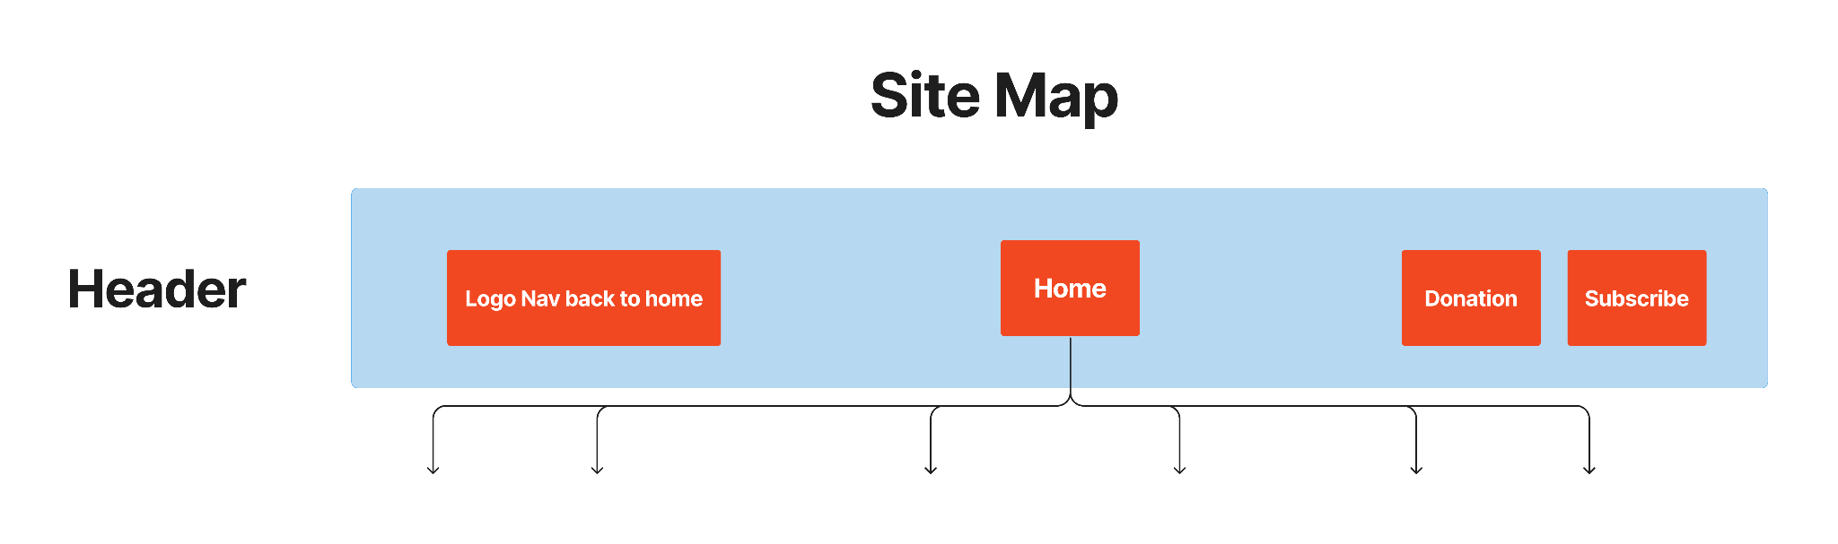
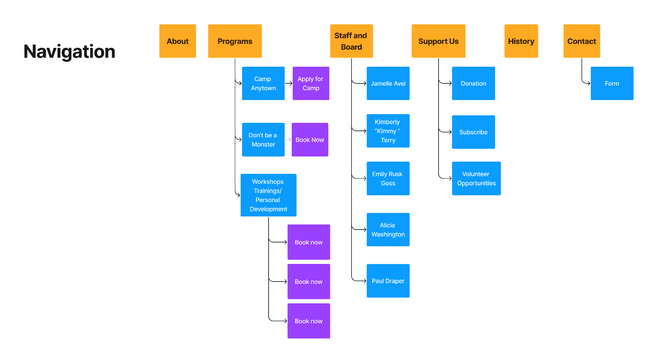

Slide 18
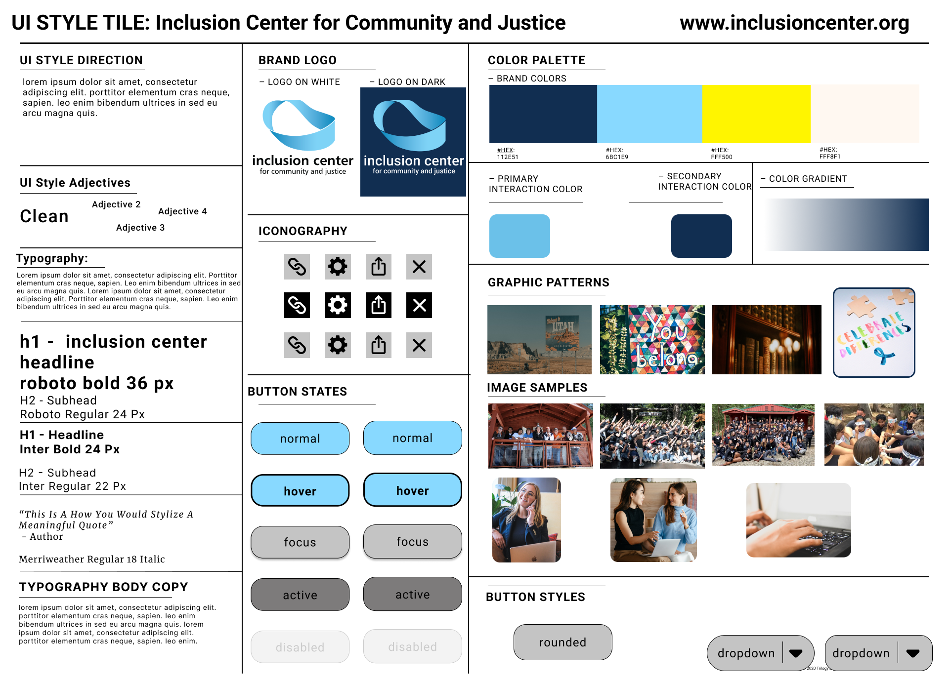
Style Guide

Slide 19
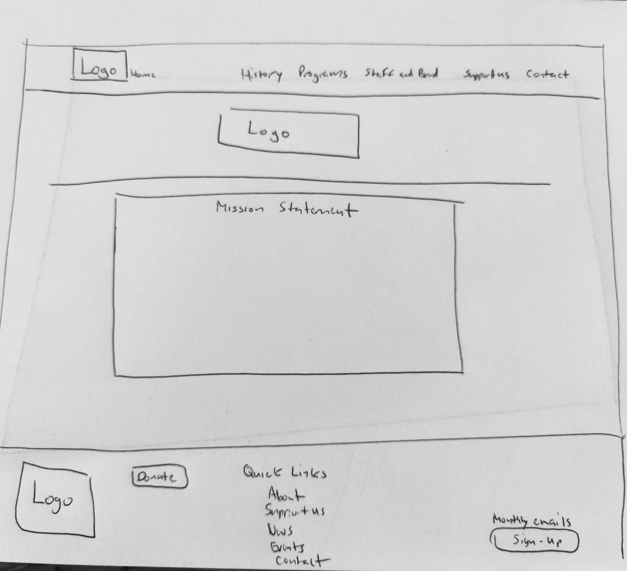
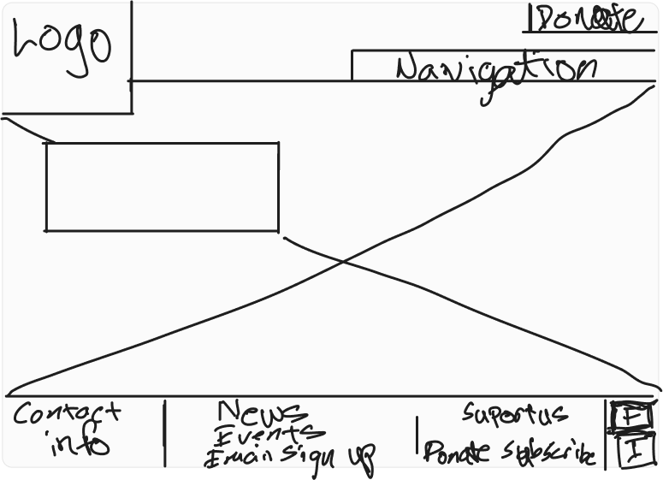
Sketching/Wireframing/Prototyping
View Sketch 2
View Sketch 1

Slide 20
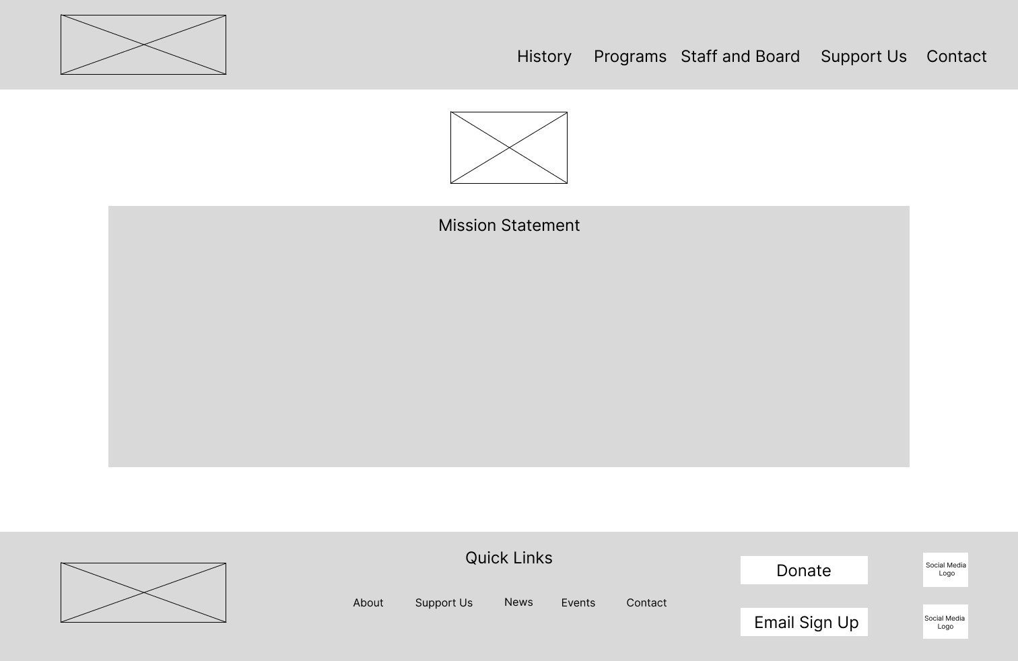
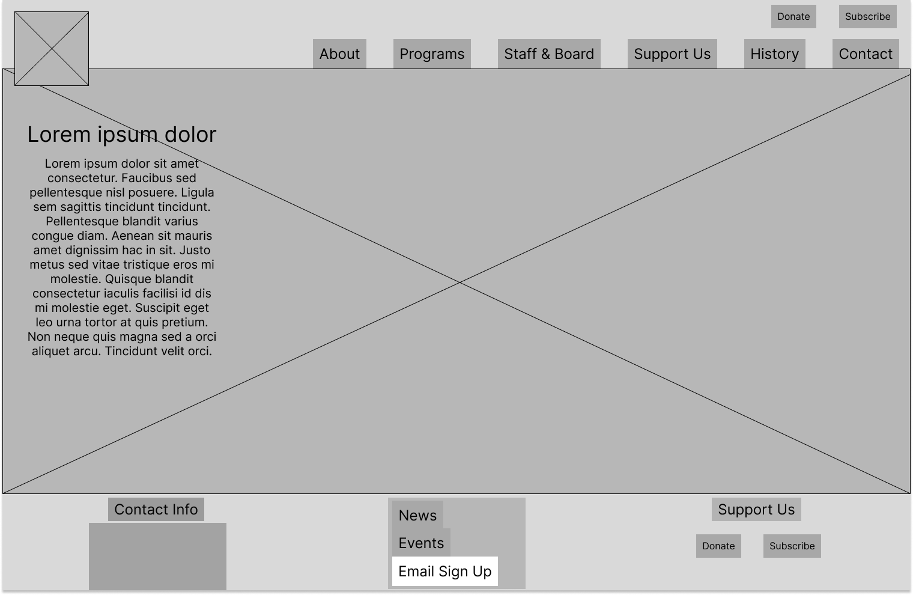
Wireframing
View Wireframe 1
View Wireframe 2

Slide 21
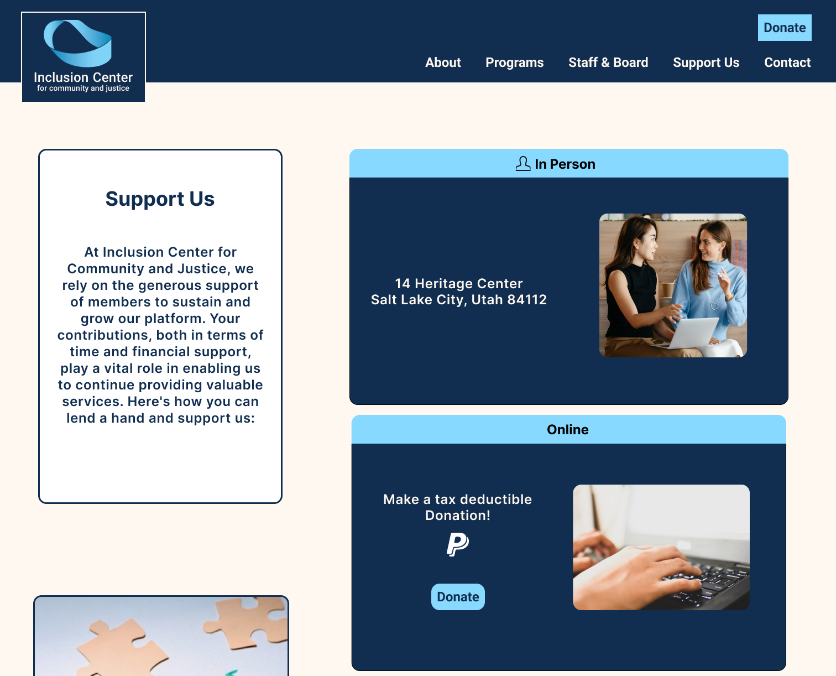
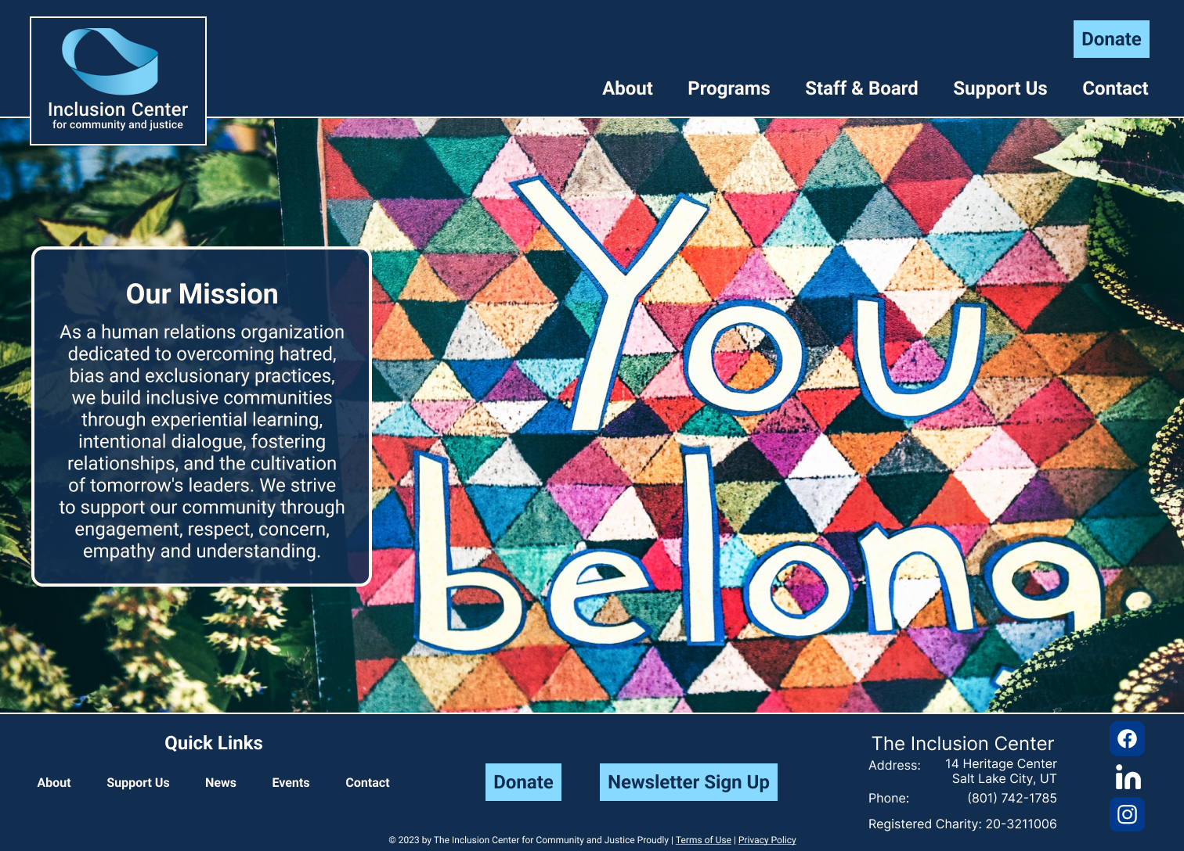
Hi Fidelity Prototyping
Desktop Hi-Fi Prototype
Hi Fi Desktop for Inclusion Center Wireframes

Slide 22
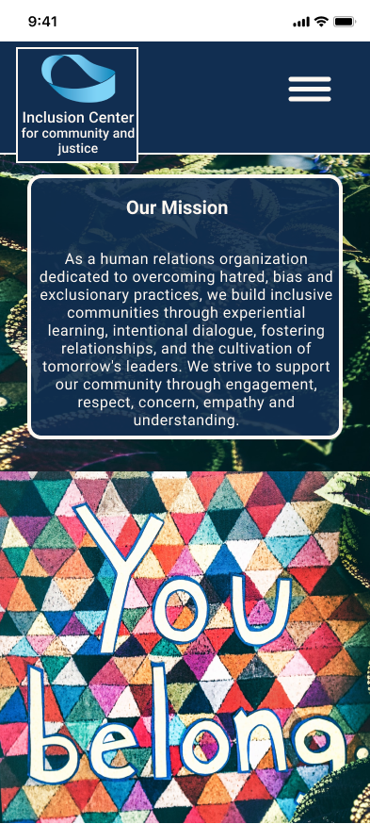
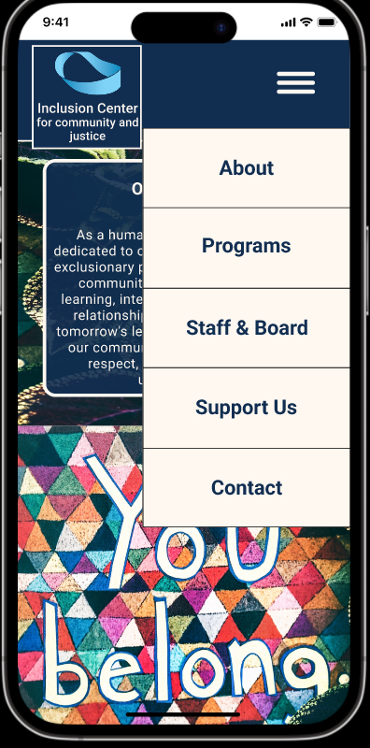
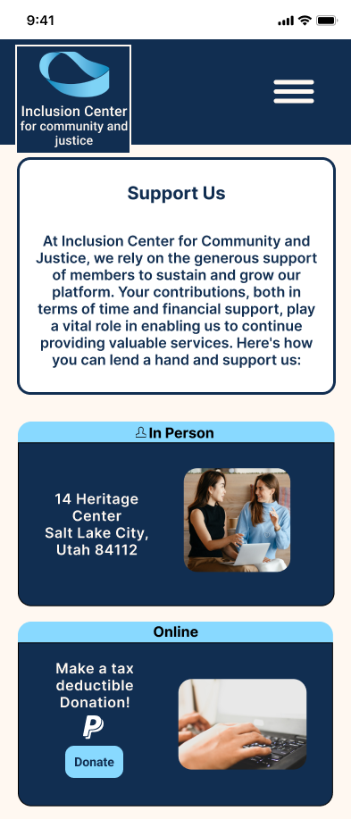
Hi Fidelity Mobile Version
Mobile Version Prototype
Hi Fidelity Mobile Version Wireframes

Slide 23
Summary
We were able to combine and collect our data to produce a user friendly desktop and mobile design. We introduced a mobile design that allows the user to more efficiently scroll the page, easier navigate, and donate with better understanding. With our thrilled to bring these improvements for you and expect significantly improved user experience. Thank you for your time!

